Slide 1
Blockchain: Security and Demonstration
Distributed ledger technology over a network of computers, which provides an alternative to the centralized system
Distributed Database
Peer-to-Peer Transmission
Transparency with Pseudonymity
Records are immutable
Computational Logic
Yao Yao, Jack Rasmus-Vorrath, Ivelin Angelov

Slide 2
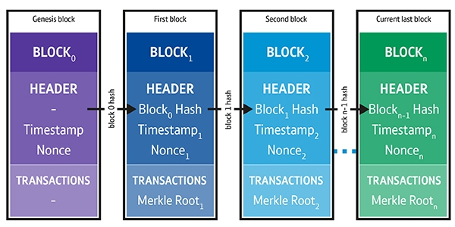
Data structure - Transactions are formatted into blocks that are linked together using a hashing algorithm. The linear nature makes past transactions immutable
Timestamps – Timestamping asserts the order of transactions is accurate and complete

Slide 3
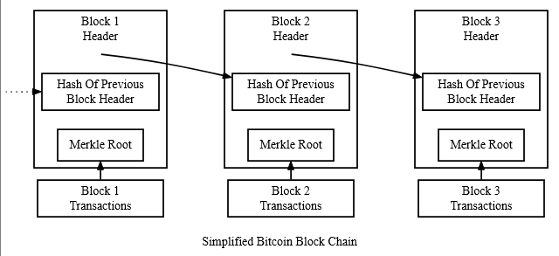
Data Integrity – Each subsequent block has the previous hash and changing the previous block would the change the hash function of all the subsequent blocks, which would cause the other nodes to reject changes. Authenticity is also fulfilled by using a private key.

Slide 4
The full copy of the chain is inside every node
Node
Node
Node
Node
Node
Node
Trust Intermediary (FI, Escrow)
Node
Node
Node
Node
Node
Node
Node
Node
Node
Node
Distributed (Peer to Peer) – Every node in the distributed network contains a copy of the full dataset since the genesis block, eliminating the centralized point of failure
Software updates by consensus – Updates to the Blockchain software are also accepted by crowd-sourcing the verification.

Slide 5
The full copy of the chain is inside every node
Node
Node
Node
Node
Node
Node
Trust Intermediary (FI, Escrow)
Node
Node
Node
Node
Node
Node
Node
Node
Node
Node
Transparency with privacy – Not only are transactions visible to everyone, but they are traceable throughout the chain whereas all the transactions in the ledger can be viewed by all participants. Despite having full copies of the database transactions, none of the users’ identities are visible

Slide 6
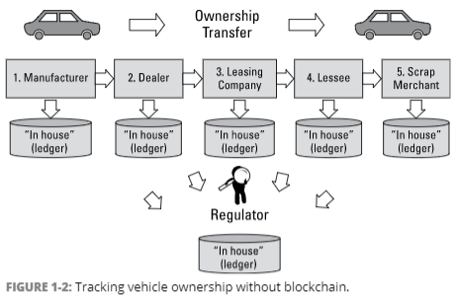
Middlemen Fees, Slow,
Overhead Fees, Audits,
Could set prices due to
inelastic demand

Slide 7
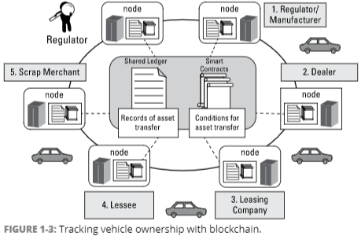
-Bananas: organic
-Sports memorabilia
-Any lifetime digital
transactions
Innoventure claims that “Blockchain technology could reduce banks' infrastructural costs by $1.520 trillion a year by 2022” [2]

Slide 8
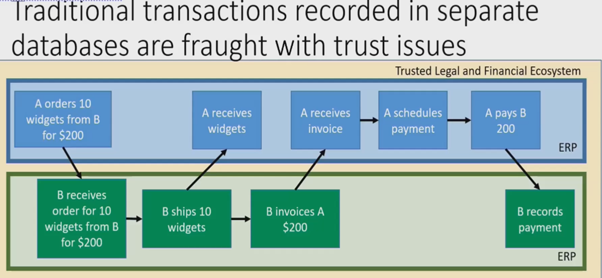
Since A and B have separate databases or have completely different ways to record, there needs to be software and people to validate and approve each step, backed by multiple institutions

Slide 9
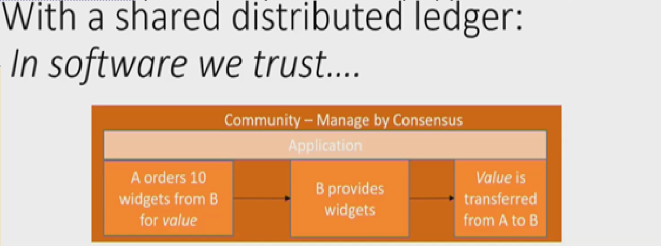
B knows A is an authorized member and has ownership of an asset
The data is shared so there is no risk that A and B will have different records
The self confirmation automatically transfer from A to B
The information is transmitted to all the member computers at once in form of new blocks

Slide 10
Example of How Blockchain Works – Front End
Transaction - Two parties exchange data
Verification - the computers or servers in the network determine if the transactions are valid
Structure - Each block is identified by a 256-bit hash and adds to the chain
Mining - Miners try to “solve” the block by making incremental changes to one variable until the solution satisfies a network-wide target. This is called “proof of work” because correct answers cannot be falsified; potential solutions must prove the appropriate level of computing power was drained in solving.
Validation - When a block is validated, the miners that solved the puzzle are rewarded and the block is distributed through the network. Each node adds the block to the majority chain
Defense - If a malicious miner tries to submit an altered block to the chain, the other nodes would detect these changes and reject the block from the majority chain, preventing corruption.

Slide 11
How Blockchain Works – Back End
Shared ledger - Append-only distributed system of record shared across business network
Smart Contract - Computer code exchange of assets without the need for middlemen.
Permissions - Ensuring appropriate visibility; transactions are secure, authenticated and verifiable
Consensus - All parties agree to network verified transaction

Slide 12
Types of Blockchain
Public – Slow, every node has the exact copy of the ledger history and is updated with every transaction. Allow for complete transparency and anonymity of the participants.
Consortium - A few predetermined nodes verify and add the transactions to the Blockchain. More efficient, higher privacy without giving all the power to one company.
Private – Companies or government institutions hold the control to some extent that verify and write the transactions onto the Blockchain. Limited read access
Permissioned – only a few have the privilege to access and validate the transactions. Can restrict access to creating smart contracts.

Slide 13
Blockchain Bitcoin Vulnerabilities
51% Attack (Mining Power): super computers are for the sole purpose of mining bitcoins using better GPU and it’s no longer worthwhile to mine Bitcoin with a home computer [13]. Not only does this create a centralization of bitcoins, but also a centralization of influence over the network.
If any mining pool controls more than 50% of the total hashing power of the entire Blockchain, it could manipulate the transaction history. The 51% attacker essentially becomes the host of the entire Blockchain [35].

Slide 14
Blockchain Bitcoin Vulnerabilities
Double-spending: The average process time of new block, which confirms the transactions, is about 10 minutes [37], where an attacker can double-spend before transactions are fully validated.
Block Fork: malicious client changes the transaction history and makes a different version of the Blockchain, making it longer than the original chain, which leads the original fork to extinction
Selfish mining: A selfish miner can create a block fork and work privately. The selfish miner keeps working privately until the public block chain length is about to catch the miner’s private block chain length, and the selfish miner publishes his branch [38]. This makes the existing public branch invalid and the selfish miner takes all credit for the overlapped works.

Slide 15
Blockchain Bitcoin Vulnerabilities
Transaction Privacy Leakage: Although Blockchains are designed with anonymity, its privacy protection protocols are not very robust. If an attacker obtains private information from a vendor such as email or shipping address, then it can be linked to the Bitcoin address and the owner’s identity [32].
Smart contract attacks: the same transaction code was ran multiple times using reentrancy vulnerability in DAO and came away with 3.6m ether, which was worth about $55 million at that time [39].
Private Key Attack: Not enough randomness during the signature process, where once the private key is lost, attackers will transfer the coins in the account and owner will not be able to trace the attackers.

Slide 16
Blockchain Vulnerabilities Prevention
Sharding - prevents cases of double spending by segmenting nodes on the database
Firewalls - prevent DDoS attacks
Removal of mining aspects - for permissioned sessions
Hard forks – during DDoS, chain is moved backward in time and a new chain is started before the attack
voting-based algorithm - all nodes in the network can validate public transactions, while offering privacy
“private” transaction id - per node basis for transactions towards private transactions

Slide 17
Once we increase security from cyber-attacks and establish additional privacy
Area | Possible applications
Financial instruments, records, models | Currency, private and public equities, certificates of deposit, bonds, derivatives, insurance policies, voting rights associated with financial instruments, commodities, derivatives, trading records, credit data, collateral management, client money segregation, mortgage or loan records, crowdfunding, P2P lending, micro finance, (micro)charity donations, account portability, air miles and corporate tokens, etc.
Public records | Land and property titles, vehicle registries, shipping registries, satellite registries, business license, business ownership/ incorporation/ dissolution records, regulatory records, criminal records, passport, birth/death certificates, voting ID, health and safety inspections, tax returns, building and other types of permits, court records, government/listed companies/civil society, accounts and annual reports, etc.
Private records | Contracts, ID, signature, will, trust, escrow, any other type of classifiable personal data (e.g., physical details, date of birth, taste) etc.
Semiprivate/ semipublic records | High school/university degrees and professional qualifications, grades, certifications, human resources records, medical records, accounting records, business transaction records, locational data, delivery records, genome and DNA, arbitration, genealogy trees, etc.
Physical access | Digital keys to home, hotel, office, car, locker, deposit box, mail box, Internet of Things, etc.
Intellectual property | Copyrights, licenses, patents, digital rights management of music, rights management of intellectual property such as patents or trademarks, proof of authenticity or authorship, etc.

